Slide 1
Design and Diversity

Slide 2
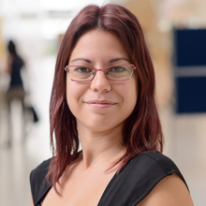
Vasiliki Mylonopoulou, PhD
Computer Engineering in Greece
Human-Computer Interaction in Umeå, Sweden
PhD in Information Processing Science in Oulu, Finland
Design technology for health behaviour change through social influence.
Division of Human-Computer Interaction Department of Applied IT
More about Vasiliki: https://vasilikimylo.com/
Contact Vasiliki Vasiliki.mylonopoulou@ait.gu.se

Slide 3
Introduction to Human-Computer Interaction

Slide 4
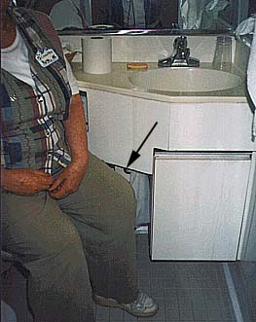
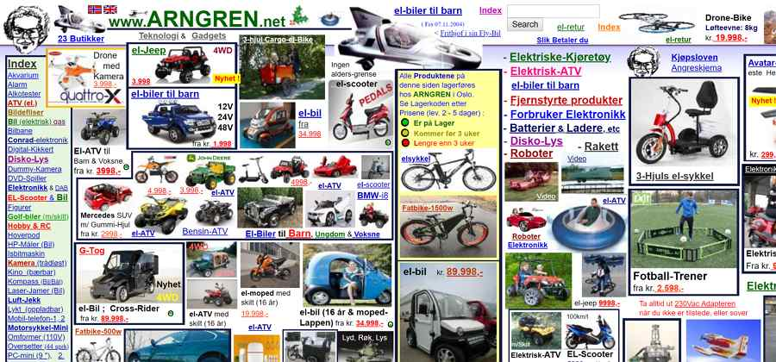
The good, THE BAD,... And the Evil
Notes:
Bad designs
http://www.baddesigns.com/examples.html

Slide 5
The good, the bad,... And THE EVIL
Notes:
https://www.darkpatterns.org/

Slide 6
THE GOOD, the bad, and the evil
Notes:
Good designs
https://jnd.org/tag/in_praise_of_good_design/
Videodeck Design
https://link.springer.com/article/10.1007/s00779-004-0293-8

Slide 7
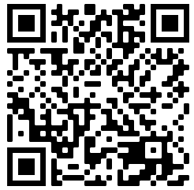
Experiences of Bad Designs
Human-Computer Interaction basics

Slide 8
Human-Computer Interaction basics
Picture by: Interaction design Beyond Human-Computer Interaction, 5th Edition (2019) by Helen Sharp, Jennifer Preece, Rogers Yvonne
Notes:
Free material related to the book:
http://www.id-book.com/help.php
Introduction to HCI based on the first 11 chapters of the book: https://www.youtube.com/watch?v=ffA0ZJeSRFc&list=PLZJO8uYi0aTGRGBxgTYFF01eXyLvSCcfZ
Fisrst 11 chapters of the book Interaction Design:
https://www.youtube.com/watch?v=vXemvrfytcM&list=PLZJO8uYi0aTH18GiHj23feaBjRAumTM3z

Slide 9
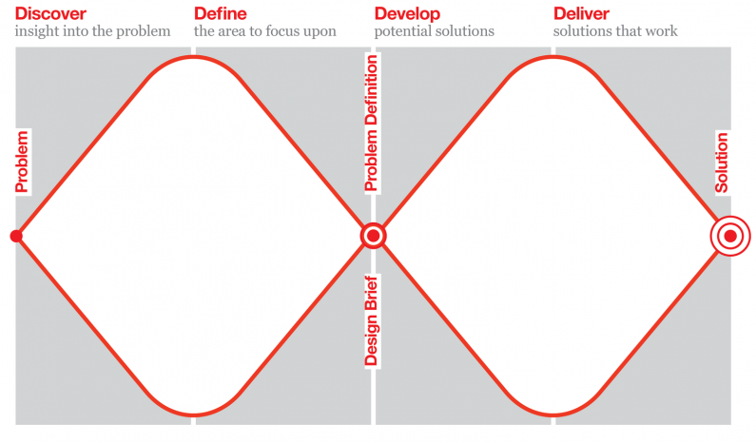
What is design?
By www.designcouncil.org.uk
Notes:
Related resourses
https://www.designcouncil.org.uk/news-opinion/what-framework-innovation-design-councils-evolved-double-diamond

Slide 10
Notes:
Read more: https://www.interaction-design.org/literature/article/5-stages-in-the-design-thinking-process

Slide 11
Simple but complex
User research
Prototype
Evaluate

Slide 12
What is really design?
Image by thedesignsquiggle.com/
Notes:
The image: https://thedesignsquiggle.com/
Sugested book:
https://www.amazon.com/Design-Way-Intentional-Change-Unpredictable/dp/0262018179

Slide 13
What is the most important thing in the design process?
Reflection

Slide 14
How many experience something like the design process?

Slide 15
We affect people’s lives
By designing the (digital) world

Slide 16
Hawaii

Slide 17
We affect people’s lives
By designing the (digital) world

Slide 18
Context

Slide 19
Let’s Walk our privilege
Notes:
https://peacelearner.org/2016/03/14/privilege-walk-lesson-plan/

Slide 20
Equality, Equity, Justice

Slide 21
Are you familiar with…
Notes:
The 2030 Agenda for Sustainable Development, adopted by all United Nations Member States in 2015, provides a shared blueprint for peace and prosperity for people and the planet, now and into the future.
Leave no one behind (LNOB) is the central, transformative promise of the 2030 Agenda for Sustainable Development and its Sustainable Development Goals (SDGs). It represents the commitment of all UN Member States to eradicate poverty in all its forms, end discrimination and exclusion, and reduce the inequalities and vulnerabilities that leave people behind and undermine the potential of individuals and of humanity as a whole.
Related literature
Sustainable goals:
https://en.wikipedia.org/wiki/Sustainable_Development_Goals
https://sdgs.un.org/goals
Leave no one behind:
https://www.un.org/development/desa/disabilities/envision2030.html
https://unsdg.un.org/2030-agenda/universal-values/leave-no-one-behind

Slide 22
Technology

Slide 23
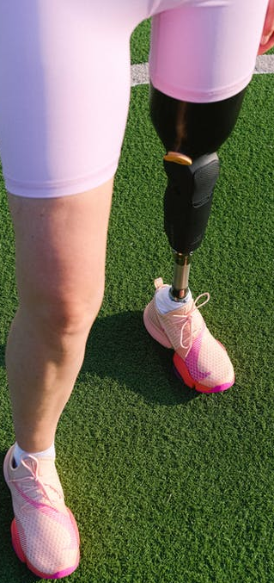
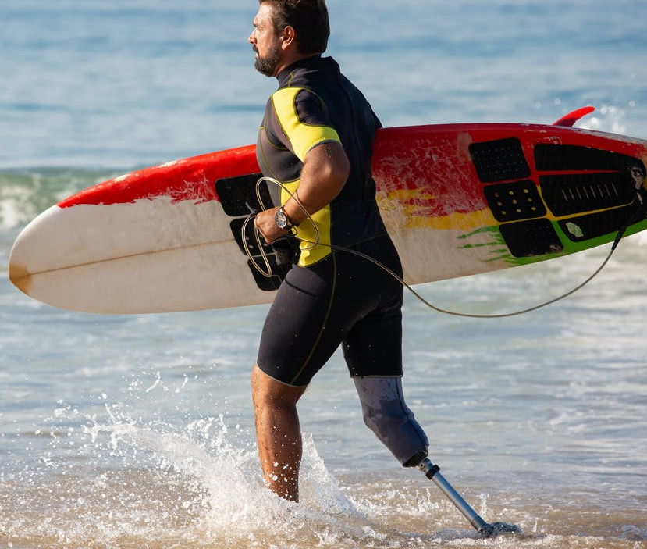
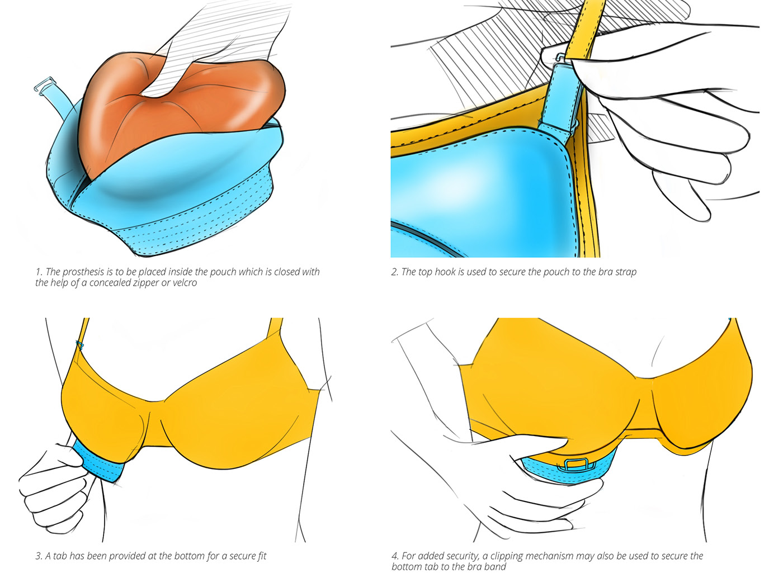
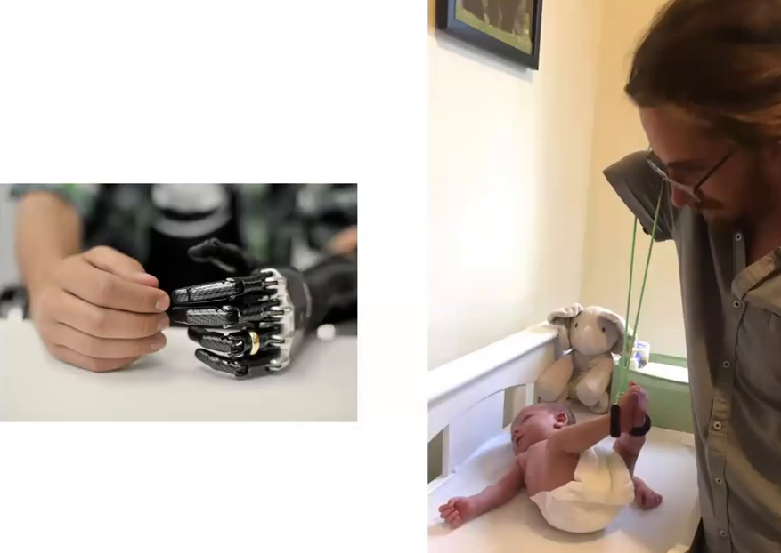
Prosthetics
Cost-effective Prosthesis for Breast Cancer Survivors by Yuhina L. Lachungpa
https://www.behance.net/gallery/37058341/Cost-effective-Prosthesis-for-Breast-Cancer-Survivors
What Can a Body Do? How We Meet the Built World
presented by Foster Young, Sara Hendren
in New America
on 08/19/2020 http://opentranscripts.org/transcript/what-can-a-body-do/
https://youtube.com/shorts/niIsf-dQ0Pc?feature=share
Notes:
Related literature
What Can a Body Do? How We Meet the Built World presented by Foster Young, Sara Hendren in New America on 08/19/2020 http://opentranscripts.org/transcript/what-can-a-body-do/
Cost-effective Prosthesis for Breast Cancer Survivors by Yuhina L. Lachungpa https://www.behance.net/gallery/37058341/Cost-effective-Prosthesis-for-Breast-Cancer-Survivors

Slide 24
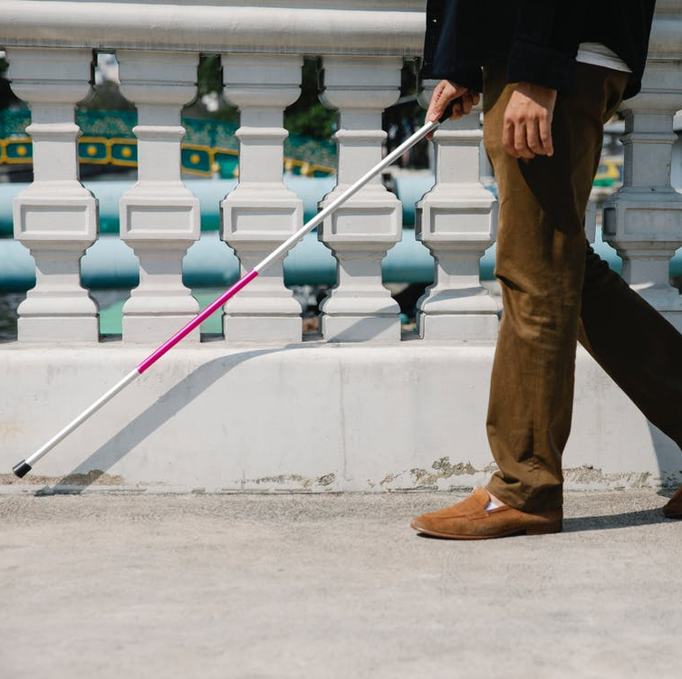
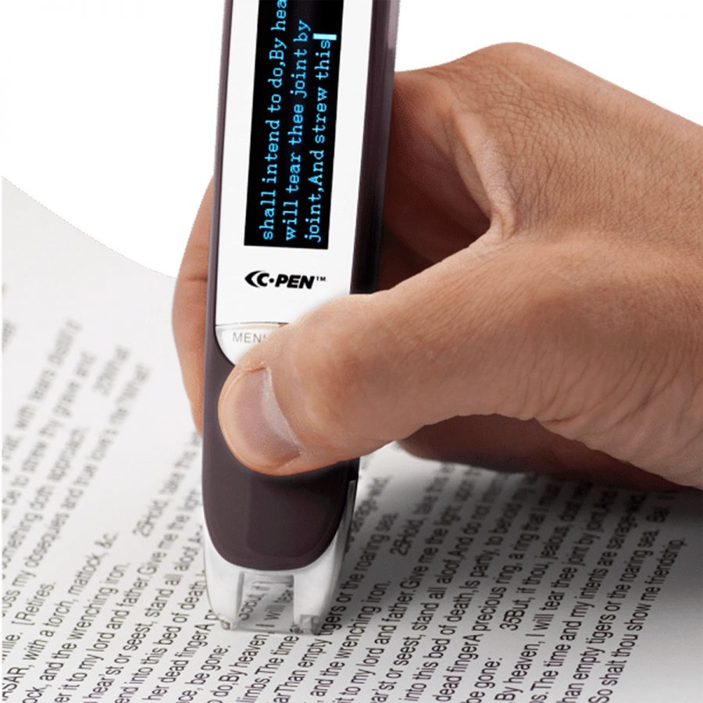
Assistive technology
Lingopen by c-Pen
Braille - PC Nero Slim Line Keyboard
Notes:
[The] president of the National Federation of the Blind, says that blind people generally love their white canes, a simple and effective piece of technology. “A couple times a year someone comes to us and says, ‘We have this great new idea for how to replace the cane!’ ” he said. “We try to be objective, but no. You’re trying to solve a problem that’s not a problem.”
More assistive tech
OrCam MyEye: https://www.youtube.com/watch?v=bbEEmc0xtvw
Hearing aids: https://www.hiddenhearing.org/hearing-aids
Desable do it yourselfs: https://www.nytimes.com/2020/07/14/style/assistive-technology.html
Brain computer interfaces: https://www.youtube.com/watch?v=QRt8QCx3BCo
Brain computer interfaces: https://www.youtube.com/watch?v=ogBX18maUiM

Slide 25
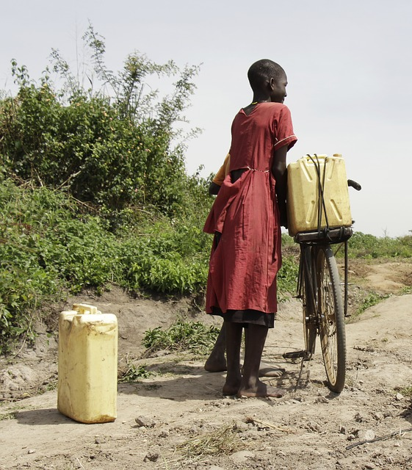
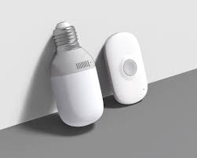
More assistive technology
Design by Ian Bok at https://thoughtfuldesign.co/2019/02/08/doorbell-for-a-hearing-impaired-person

Slide 26
For whom are you working?
What Can a Body Do? How We Meet the Built World
presented by Foster Young, Sara Hendren
in New America
on 08/19/2020 http://opentranscripts.org/transcript/what-can-a-body-do/
Cost-effective Prosthesis for Breast Cancer Survivors by Yuhina L. Lachungpa
https://www.behance.net/gallery/37058341/Cost-effective-Prosthesis-for-Breast-Cancer-Survivors
Notes:
TEDx video: https://www.youtube.com/watch?v=5t7kFRQ5S-4
Searching for empathy (paper presentation in NordiCHI2020 talking about the preconseptions in the tools we use to design) https://www.youtube.com/watch?v=SLhfgWZUjw0
About prosthetics, testimonies
https://www.inputmag.com/culture/cyborg-chic-bionic-prosthetic-arm-sucks
https://www.limbs4life.org.au/news-events/news/bionic-solutions-too-good-to-pass-or-too-bad-to-grab

Slide 27
Thinking excersise
What does the word “normal” mean for you?
How do you think our perception of normal influence our understanding of the users?
How do you perceive the term “assistive technology”?

Slide 28
Let’s talk about unicorns
Or set the mindset

Slide 29
Who is Normal?
15% of the global population live with disabilities
45% by 2030
77% in European region live with NCDs
44% in Canada
45% in USA
Notes:
References for these data can be found at the blogpost: a real person living in a world designed for unicorns
https://www.vasilikimylo.com/post/a-real-person-living-in-a-world-designed-for-unicorns

Slide 30
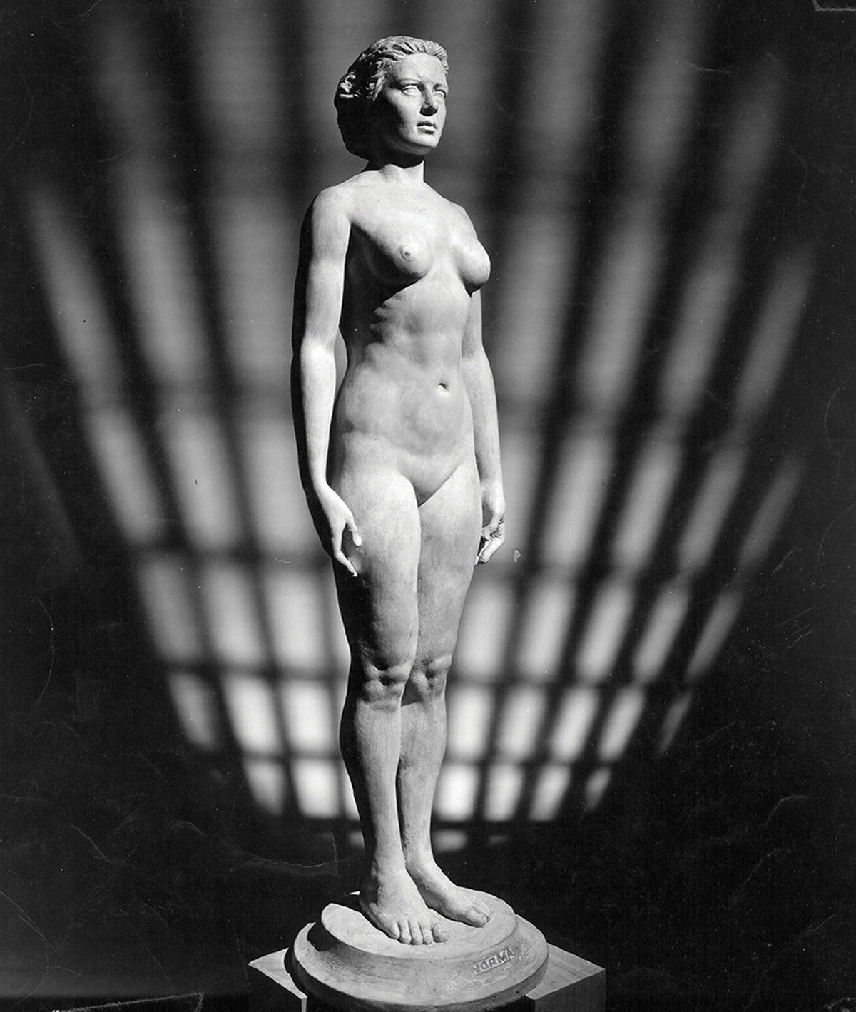
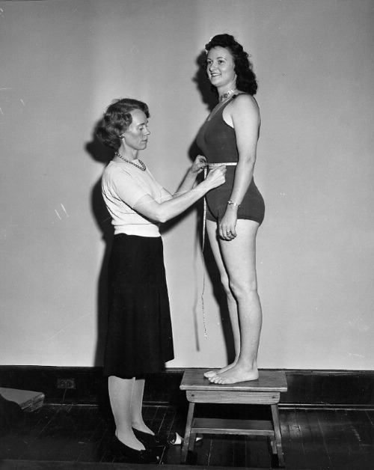
Is this normal?
Images taken from https://sashaarchibald.com/Norm-Norma
Notes:
carved in 1943 as exact replicas of the average American man and woman.
The statues were the work of Robert Latou Dickinson
More about Norm/Norma:
https://www.cabinetmagazine.org/issues/15/cambers.php
https://sashaarchibald.com/Norm-Norma

Slide 31
This is Normal
Normal Sucks: How to Live, Learn, and Thrive, Outside the Lines by Jonathan Mooney
Notes:
Video: https://www.youtube.com/watch?v=Brjx27Vm5x8
Refered book: https://www.amazon.com/Normal-Sucks-Learn-Thrive-Outside-ebook/dp/B07CRN9G1N
Homosexuality as medical condition before and after: https://en.wikipedia.org/wiki/Homosexuality_in_DSM

Slide 32
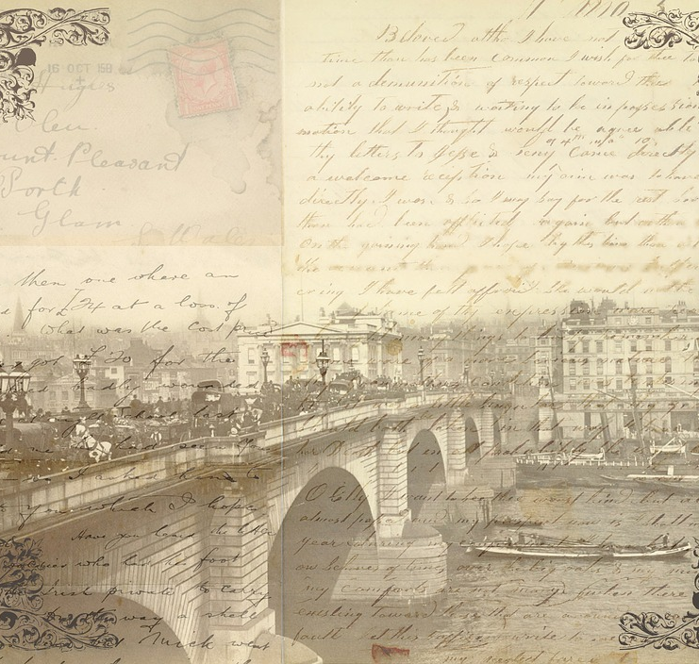
A letter

Slide 33
Pachakuti
By the world’s culture museum at Gothenburg Sweden – exhibition crossroads Varldskulturmuseet – Krosvägar
Notes:
http://korsvagar1.varldskulturmuseet.se/index.php?page=images&itemurl=http://kulturarvsdata.se/SMVK-VKM/objekt/96582&uri=http://kulturarvsdata.se/SMVK-VKM/showcase/2410228

Slide 34
Ability

Slide 35
Able woman disable men!
Notes:
Woman video: https://www.youtube.com/watch?v=Spb0bo3IT0I
Men video: https://www.youtube.com/watch?v=DUwXN01ARYg

Slide 36
Ability, and democracy
Notes:
2017 in E.U. parliament: Of course women should get paied less
https://www.youtube.com/watch?v=40hhc0cjYyg

Slide 37
Misconceptions

Slide 38
How do we build our digital world?

Slide 39
Identity: Everyone Here Spoke Sign Language…
Notes:
Music in the deaf space – experience of music
Video link
https://www.youtube.com/watch?v=u12uKwSwX3k
Suggested literature Everyone Here Spoke Sign Language
https://www.amazon.com/Everyone-Here-Spoke-Sign-Language/dp/067427041X

Slide 40
What is Disability?
Notes:
Who is the problematic here?
What if the person hearts themselves?
Blind spots pt.1: Designers
https://www.vasilikimylo.com/post/blind-spots-pt-1-designers

Slide 41
Models of disability
Moral model of disability: people are morally responsible for their own disability. For example, the disability may be seen as a result of bad actions of parents if congenital, or as a result of practicing witchcraft if not
Medical Model of Disability: viewing disability as a problem of the person, directly caused by disease, trauma, or other health condition which therefore requires sustained medical care provided in the form of individual treatment by professionals.
Social model of disability: sees the issue of "disability" as a socially created problem and a matter of the full integration of individuals into society.
Sourse: https://www.disabled-world.com/definitions/disability-models.php
Notes:
Sourse: https://www.disabled-world.com/definitions/disability-models.php

Slide 42
World Health Organization
Disability refers to the interaction between individuals with a health condition and personal and environmental factors
Sourse: https://www.who.int/news-room/fact-sheets/detail/disability-and-health
Notes:
Sourse: https://www.who.int/news-room/fact-sheets/detail/disability-and-health

Slide 43
Thinking excersise
What did you find interesting from this part of the presentation?
What did you have hard time to perceive?
Why do you think you have hard time to perceive it?

Slide 44
Today
Tomorrow
Introduced to HCI
Technology that exist to support the diverse needs of humanity
Introduced to disability and set the mindset for tomorrow
Universal and inclusive design
From user centre to participatory design to PPIs
Empathy framework and empathy map
Experience and practice

Slide 45
1 Credit
https://www.vasilikimylo.com/designing-for-diversity

Slide 46
Design Concepts and Tools

Slide 47
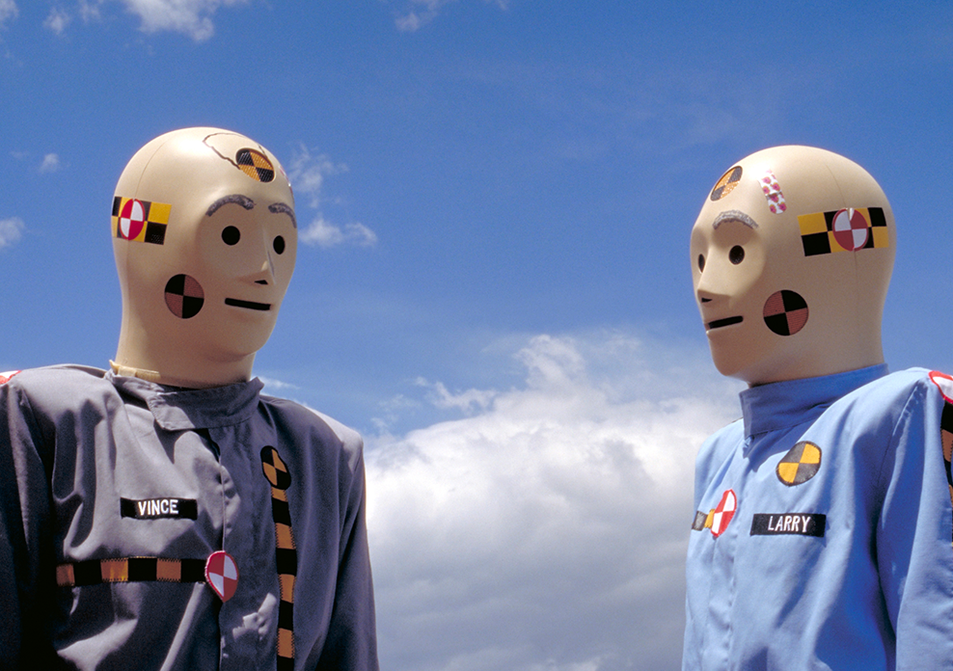
When the “other” is the designer
Picture taken from Public Health Post: It’s a crush test, dummy https://www.publichealthpost.org/research/its-the-crash-dummy/
Picture taken by Unlocking kitchens empowering girls and fighting climate change by Stéphanie Fonseca Johann https://blog-isige.minesparis.psl.eu/2020/09/25/unchocking-kitchens/
Notes:
Sugested literature:
Invisible women
https://www.amazon.com/Invisible-Women-Data-World-Designed/dp/1419729071
Crash-test Dummies
https://www.publichealthpost.org/research/its-the-crash-dummy/
https://www.consumerreports.org/car-safety/crash-test-bias-how-male-focused-testing-puts-female-drivers-at-risk/
Biomass fuel for energy
https://blog-isige.minesparis.psl.eu/2020/09/25/unchocking-kitchens/
Cellphone size
Voice recognition

Slide 48
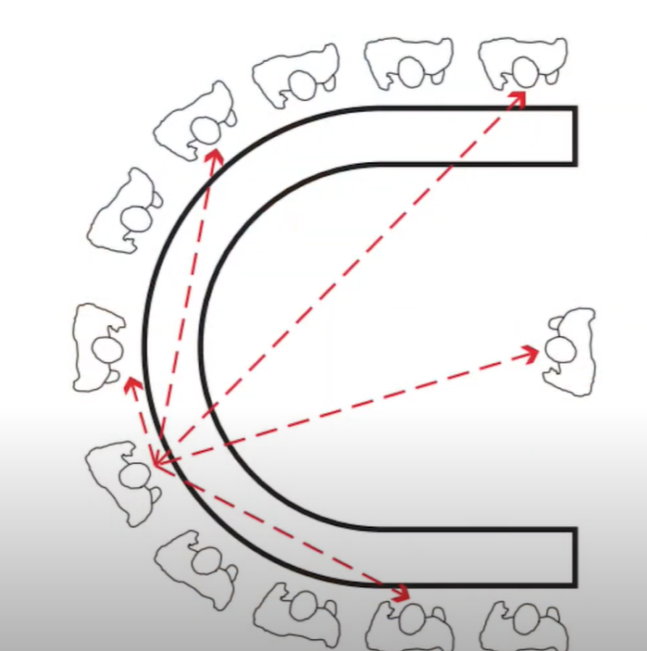
World experience body experience
What we lose if we are unable to include diversity
Experience of life
Picture taken by https://www.gallaudet.edu/campus-design-and-planning/deafspace/
Notes:
Deaf space project:
https://www.gallaudet.edu/campus-design-and-planning/deafspace/
https://www.youtube.com/watch?v=u12uKwSwX3k
Sugested literature
The Rejected Body
https://www.amazon.com/Rejected-Body-Philosophical-Reflections-Interaction-ebook/dp/B00AZKVRWU
What Can a Body Do?: How We Meet the Built World https://www.amazon.com/What-Can-Body-Do-Built-ebook/dp/B082H35TV9/

Slide 49
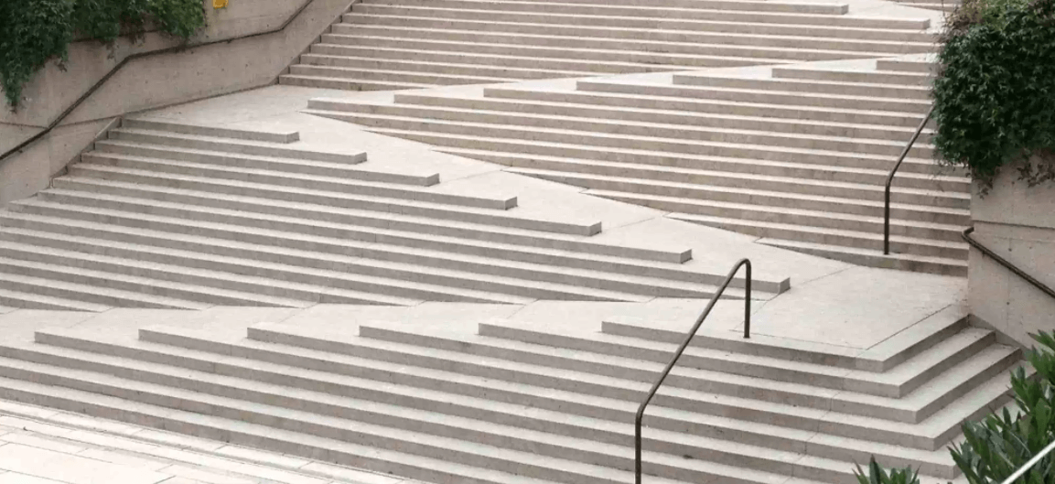
Universal and inclusive design
Picture taken by inner sydney voice: making neighborhoods accessible though universal design https://innersydneyvoice.org.au/our-resources/resources-waterloo-community-capacity-building-project/universal-design/
Notes:
Inlusive desing
Exploring the needs
Creating solutions
Evaluating how well the needs are met
Microsoft inclusive design follows the steps:
Recognize exclusion.
Solve for one, extend to many.
Learn from diversity.
Related resourses
Universal desing pictures: https://innersydneyvoice.org.au/our-resources/resources-waterloo-community-capacity-building-project/universal-design/
Microsoft inclusive design:
https://www.microsoft.com/design/inclusive/
Panel on accessibility, inclusiveness, and universality: https://accessibility.deque.com/accessibility-universal-design-inclusive-design-webinar

Slide 50
User center and participatory design and PPIs
Image taken from: Sanders, E. B. N., & Stappers, P. J. (2008). Co-creation and the new landscapes of design. Co-design, 4(1), 5-18.
Notes:
Suggested literature
Image taken from: Sanders, E. B. N., & Stappers, P. J. (2008). Co-creation and the new landscapes of design. Co-design, 4(1), 5-18.
General knowledge:
Participatory design: https://en.wikipedia.org/wiki/Participatory_design
User centered design: https://en.wikipedia.org/wiki/User-centered_design

Slide 51
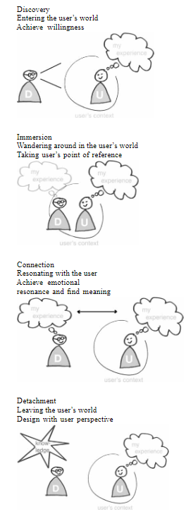
Empathy: In an out approach for designer’s blind spots
Kouprie, M., & Visser, F. S. (2009). A framework for empathy in design: stepping into and out of the user's life. Journal of Engineering Design, 20(5), 437-448.
Notes:
Empathy framework: Kouprie, M., & Visser, F. S. (2009). A framework for empathy in design: stepping into and out of the user's life. Journal of Engineering Design, 20(5), 437-448.

Slide 52
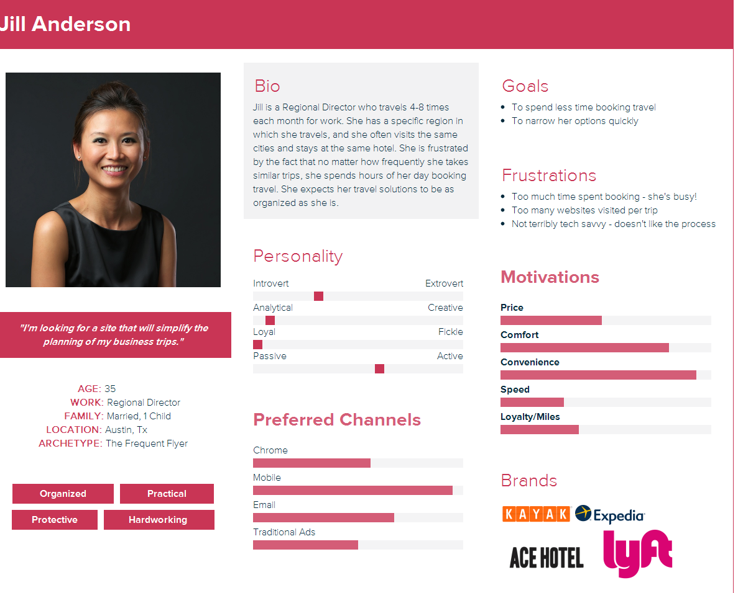
Persona
Important characteristics
Image
Name
Quote
Short bio
Likes/dislikes
Notes:
Representation of the users
Not based on statistical data but made as realistic as possible
They aim to increase empathy
They are used to help the design team to focus on the user

Slide 53
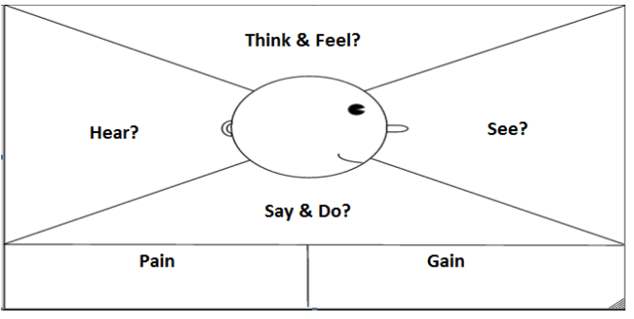
Empathy: Persona with empathy map
Ferreira, B., Silva, W., Oliveira, E., & Conte, T. (2015, July). Designing Personas with Empathy Map. In SEKE (Vol. 152).
Notes:
Empathy persona:
Ferreira, B., Silva, W., Oliveira, E., & Conte, T. (2015, July). Designing Personas with Empathy Map. In SEKE (Vol. 152).

Slide 54
Practice

Slide 55
Empathy: In an out approach for designer’s blind spots
Kouprie, M., & Visser, F. S. (2009). A framework for empathy in design: stepping into and out of the user's life. Journal of Engineering Design, 20(5), 437-448.
Notes:
Empathy framework: Kouprie, M., & Visser, F. S. (2009). A framework for empathy in design: stepping into and out of the user's life. Journal of Engineering Design, 20(5), 437-448.

Slide 56
Do and reflect while you are doing – Be back in 15-20 min
Wheelchair users
Pick one direction
Find the closest wheelchair user toilet towards that direction
Blind people – pick one (the person accompanying you is for protection not to tell you what to do)
1. Find your way to the downstairs restaurant
2. Find your way to the restaurant on the left of TellUs and find a way to understand what is the menu
3. Find your way to the toilets and try to use them (wash your hands afterword)

Slide 57
Last min discussion... To be continued
How did you feel as...blind/wheelchair user?
What do you think would have changed if you were living for years in this state of body?

Slide 58
...Last min discussion
How did you feel as...blind/wheelchair user?
What do you think would have changed if you were living for years in this state of body?

Slide 59
Tasks
Divide into groups – we do this together
Educate yourself for the difference
What do they find difficult to do
Why
How they feel
Fill in the empathy map

Slide 60
Make a persona.... with

Slide 61
Empathy: Persona with empathy map
Ferreira, B., Silva, W., Oliveira, E., & Conte, T. (2015, July). Designing Personas with Empathy Map. In SEKE (Vol. 152).
Notes:
Empathy persona:
Ferreira, B., Silva, W., Oliveira, E., & Conte, T. (2015, July). Designing Personas with Empathy Map. In SEKE (Vol. 152).

Slide 62
Create your persona with the empathy map
https://app.xtensio.com/templates or https://miro.com/
Or
https://app.mural.co/
Or
pen & paper

Slide 63
Focus on a person who is different and its activity
Examples
Stargardt Disease (look up also blind life) - fill in a form online
Dyslexia - read or write a post on social media – think about spellings, answering to comments that you misread, words that cannot be caught by the spellcheck e.g. bye, bey, buy etc.
Blind - video calls, they need to know if they look at the camera
Wheelchair user A spinal cord injury or Multiple sclerosis - What to track their activity

Slide 64
Vasiliki Mylonopoulou https://vasilikimylo.com/ Department of Applied IT Division of Human-Computer Interaction https://hci-gu.github.io/

